Slide 1
BTP Presentation
-Stock market analysis
-Anirudh Joshi(17ucs023)
-Eklavaya Singh(17ucs054)
-Khushwant Ramchandani(17ucs079)

Slide 2
Table of contents
Introduction
Understanding the problems
Proposed models and methodologies
Results
Suggested improvements
Conclusion

Slide 3
Introduction
To understand the depth and the need of stock market analysis we must understand the importance of stock markets.
Most of the major factors that influence the international reputation of any country or a company today are related to economy and stock market. The rise and fall of stocks are dependent on many factors; both abstract and numerical.
It is necessary to try to predict stock markets, because even today their rise and fall remains a mystery. However, this mysterious nature does not reduce their importance in a person’s daily life and still they may make a person rich or bankrupt in a very short span of time.
Thus, to reduce the risk factor and to make healthier financial decision, it has become the need of the hour to be able to predict financial markets.

Slide 4
Understanding the problems
01
Even though demand and supply play a major role in the rise and fall of a stock; the latter may also depend on socio-political factors, predicting which is very difficult
02
The demand and supply of a stock is largely based on market sentiments, and hence, their arises a need for sentiment analysis as well.
03
Even though the stock market is a monolithic entity, the factors influencing the stock market do not move in tandem

Slide 5
Proposed Model and Methodologies
ARIMA Model
Holt-Winters Model
Artificial Neural Nets (ANN)
Recurrent Neural Nets

Slide 6
ARIMA MODEL
An ARIMA Model is a statistical model which provides an easy and powerful method for analysing and forecasting time series by explicitly catering to standard structures of time series data.ARIMA stands for AutoRegressive Integrated Moving Average.It is mostly applicable of stationary time series.It involves the following steps:-
Visualize the time series
Stationarize the series
Find the optimal parameter
Build ARIMA model
Make predictions

Slide 7
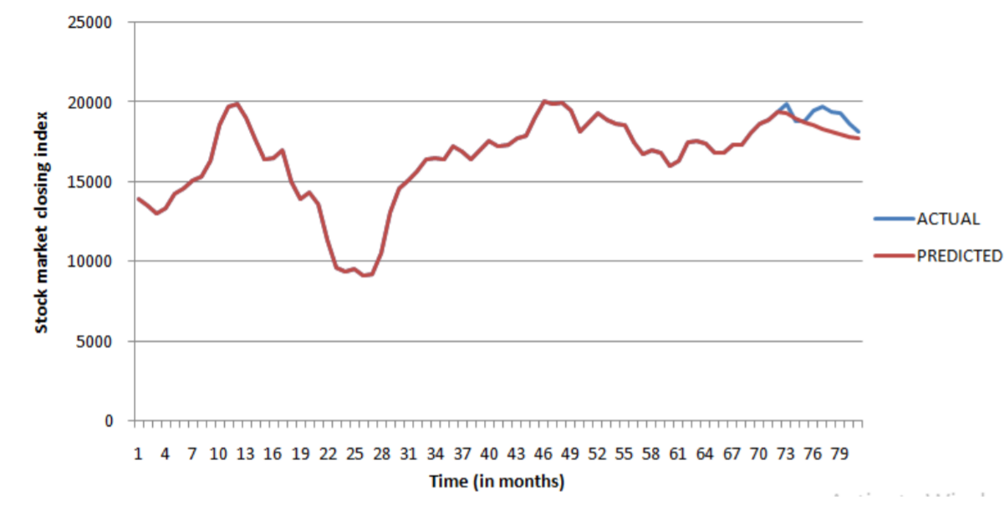
ARIMA MODEL
A linear regression model is built which includes the appropriate number and type of lag and moving average terms, and the time series is prepared by differentiating it a number of times thereby removing seasonal terms and trends that have a negative impact on regression model. Hence, making it stationary.
Plot of Actual and Forecasted value Vs Time for Arima model

Slide 8
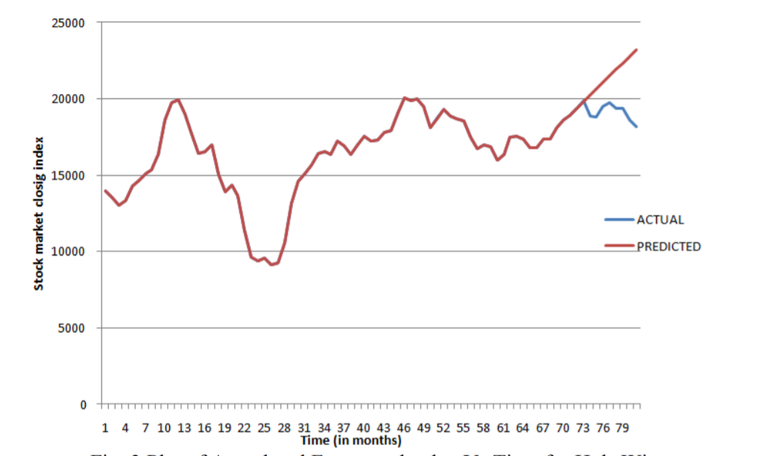
2. HOLT-WINTERS MODEL
Holt-winters model breaks the series into 3 parts that are trend,base and seasonality, the model finds 3 smoothing parameters that constitute trend,level and seasonality terms.Holt-Winters has performed significantly better than other models in terms of prediction.Holt-Winters exponential smoothing method, with trend and seasonal fluctuations is usually used in short-term forecast of economical development trend.After removing the seasonal trends from the data, it is taken as input for the function and in return the Holt Winters makes the pre calculations that are necessary for the forecasting purpose.
Plot of Actual and Forecasted value Vs Time for Holt-Winters model
HWStock1_ng= HoltWinters(ds,gamma=FALSE) predHW=predict(HWStock1_ng,n.ahead=9)

Slide 9
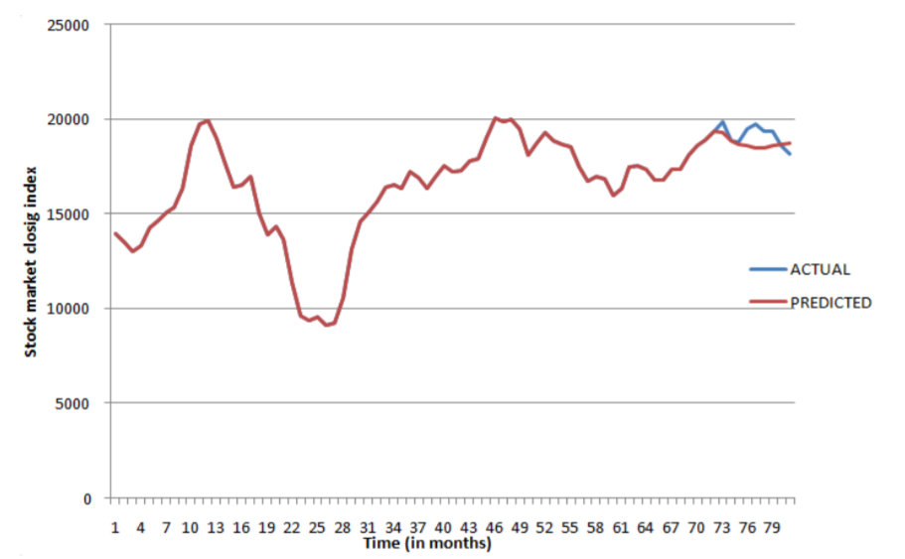
3. ARTIFICIAL NEURAL NETWORK (ANN)
Artificial Neural Network is considered as one of the most efficient techniques in the field of data analytics.Neural networks consists of a number of simple processing elements operating in parallel. In a neural network model, lagged terms can be used just as it is used in Autoregression model. The lagged values of time series data could be used as input to neural network. In forecasting problem, the number of inputs and number of processing elements i.e. neurons are flexible in the hidden layer whereas there is only a single neuron in the output layer.
Plot of Actual and Forecasted value Vs Time for ANN model
Npred <- nnetar(ds,repeats = 20,p=5,P=1,size=3)
pred1 <- predict(Npred,n.ahead = 9)

Slide 10
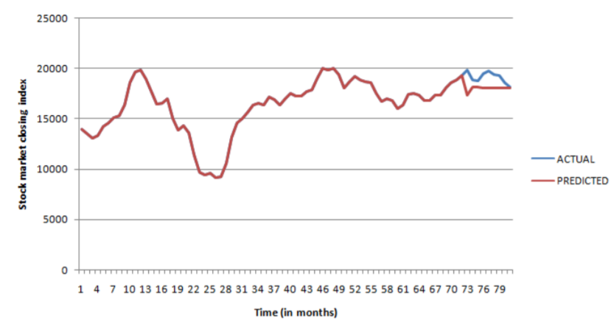
4. RECURRING NEURAL NETWORK
RNN are called as recurrent because they perform the same task for every element of a sequence with the output dependent on the previous computations.
model <- trainr( Y= trainy,X=trainx,learningrate =0.05,hidden_dim = 5,numepochs = 2600) pred <- predictr(model,testx)

Slide 11
Results
Mean Absolute Percentage Error (MAPE)
MAPE is one of the important methods which is used to evaluate the accuracy and precision of the predictions made.
It is used to measure percentage of divergence of the predicted Stock prices through the predictive models from the actual Stock Prices.
It is calculated as:
Mape = mean( abs ( (actual-predicted) / actual ) ) * 100

Slide 12
Results
Model MAPE
ARIMA 3.99251
Holt-Winters 12.56901
Artificial Neural Network 2.83544
RNN 5.808394

Slide 13
Results
As per the results observed, Artificial Neural Network has better accuracy when compared to the other predictive models in terms of the Mean absolute percentage error.
After this Arima model seems to be a promising model with an MAPE of 3.99251.
Holt-Winters proves to be least accurate based on MAPE.
Predictions of the Stock market prices that are generated using these stochastic techniques including the ARIMA Model, Holt Winters Artificial Neural Nets and Recurrent Neural Network are easy to implement, Reliable and Justifiable.

Slide 14
Conclusion
The task of stock market analysis and prediction is very difficult due to its non linear, dynamic and changing nature, there are excessive volatility phenomena in the financial market which can not be explained by basic economic factors.
Various mathematical models such as ANN, Arima model have been analyzed for robustness in the task of prediction stock market price.
However there is still need of exploring ensemble models in this field.

Slide 15
Conclusion
ANN model has been compared with other models for making prediction and has produced really impressive results. The model has been proven robust in predicting the future stock market indices. The robustness of the model has been checked by evaluating various parameters such as accuracy, precision as calculated by MAPE.
In order to improve the accuracy of forecasting model, hybrid models could be effectively used for complex time series that has both linear and non-linear components.

Slide 16
References
Stock Market Analysis using Supervised Machine Learning
Literature review on Artificial Neural Networks Techniques Application for Stock Market Prediction and as Decision Support Tools
Analysis of Investor Sentiment and Stock Market Volatility Trend Based on Big Data Strategy
Comparative Analysis of Various Stock Prediction Techniques
Stock Market Prediction based on Social Sentiments using Machine Learning
Optimised Prediction Model For Stock Market Trend Analysis
A Review of Stock Market Prediction Using Neural Networks
Survey of Stock Market Prediction Using Machine Learning Approach
Efficacy of News Sentiment for Stock Market Prediction

Slide 17

Thank you!

